Slide 1
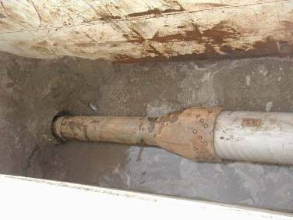
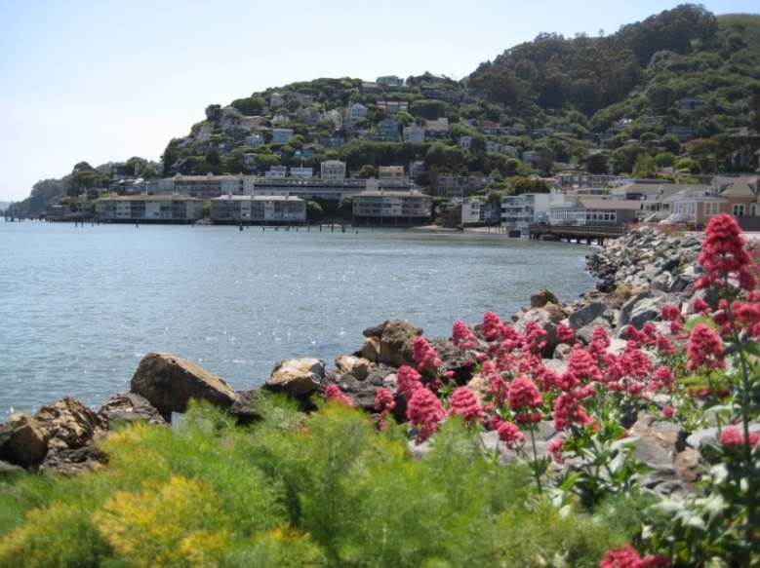
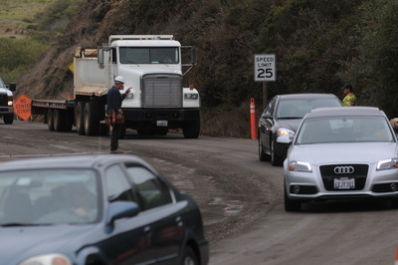
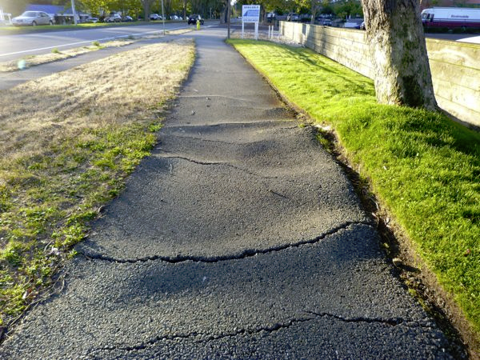
Sausalito Essential Services Funding Measure Proposal
Investing in the Quality of Sausalito’s Future

Slide 2
City Services Needs
Current levels of service are adequately funded
The budget is structurally balanced and sound
However, future additional resources are required to address needed infrastructure investment while maintaining the long-term financial viability of the City
Funds needed to maintain/repair aging storm drains, neighborhood streets, and broken sidewalks

Slide 3
Reforms for Long Term Financial Viability
The City has already made key reforms to maintain long-term financial viability
City Council enacted sweeping and award-winning pension reform that has manifested significant results:
Lowered annual pension costs by $1 million
Lowered future growth rate of pension costs so that current levels of service are adequately funded
Eliminated multi-millions of dollars in past and future pension liabilities
As attested to by the City’s Actuary, Sausalito’s pension reform exceeds that of other California local government efforts.
City Council will continue to seriously examines policies and legislation that address employee pensions and reforms.
Even with these reforms/savings, the City needs additional funds to address local services and infrastructure needs

Slide 4
Two-thirds of respondents continue to feel that things in Sausalito are on the right track– a fantastic finding.
Do you feel things in the City of Sausalito are generally going in the right direction or do you feel things have gotten off on the wrong track?
2011
2014

Slide 5
Community supports the general sales tax funding essential services and projects throughout the survey.
If the election were held today, do you think you would vote “Yes” in favor of this measure or “No” to oppose it?
Initial Vote
After Information
Total Yes
Total No
Undecided

Slide 6
Community Supports many types of essential services and projects including:
Total Impt.
92%
92%
91%
95%
94%
91%

Slide 7
~140 California Cities have add-on Sales Tax including:
Marin County
Novato ½¢
San Rafael ¾¢
Alameda
Town of Corte Madera ½¢
City of Fairfax ½¢
City of Larkspur ½¢
City of Novato ½¢
Town of San Anselmo ½¢
City of San Rafael ¾¢
Corte Madera ½¢
Fairfax ½¢
Larkspur ½¢
City of Albany ½¢
City of San Leandro ¼¢
City of Union City ½¢
San Anselmo ½¢
Marin County
Sonoma County
Contra Costa
City of Cotati ½¢
City of Healdsburg ½¢
City of Rohnert Park ½¢
City of Santa Rosa ½¢
City of Sebastopol ¾¢
City of Sonoma ½¢
City of Antioch ½¢
City of Concord ½¢
City of El Cerrito 1¢
City of Hercules ½¢
City of Moraga 1¢
City of Orinda ½¢
City of Pinole ½¢
City of Pittsburg ½¢
City of Richmond ½¢
City of San Pablo ½¢
San Mateo
City of Half Moon Bay ½¢
City of San Mateo ¾¢
Notes:
November 5 2013
Measure B: Town of Corte Madera sales tax Measure C: City of Larkspur sales tax Measure D: Town of San Anselmo sales tax Measure E: City of San Rafael sales tax
Renewed former 0.5 Plus an additional 0.25
November 6 2012
¼ ¢ for parks
November 8 2011
Measure D: Fairfax Sales Tax
November 2, 2010
Measure F: Novato Sales Tax Increase
November 2008
Sonoma Marin ¼¢

Slide 8
Transaction and Use (Sales) Tax
Participant Diversity
Excludes groceries and prescription medicine
Residents, workers, businesses, visitors
Diverse tax base ensures tourists pay their fair share for their impact on infrastructure and services
Impact on Low / Fixed Income Residents
Primarily consume non-taxable goods and services
Tax base is weighted towards discretionary income purchases
Impact on Business Community
Tax paid by purchasers rather than businesses
Business-to-business transactions
Anecdotal evidence points to little impact on business profitably
Impact on Residential Community
Most residential non-discretionary income spending is tax-exempt (e.g., groceries, prescription medicine, mortgages, rent, utilities, services, etc.)
Notes:
Maximizes participant diversity
Minimizes impact on low/fixed income
Although impacts business community indirectly tax is paid by visitors
Minimizes impact on residents
Utility users tax
Parcel tax
TOT

Slide 9
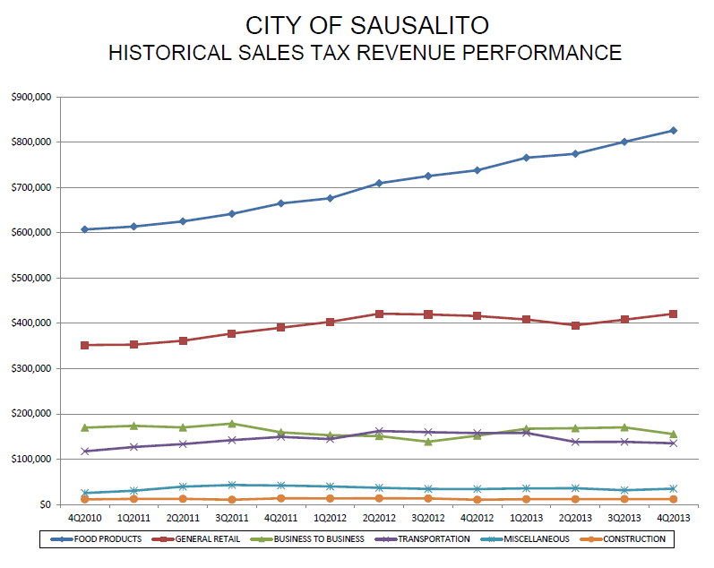
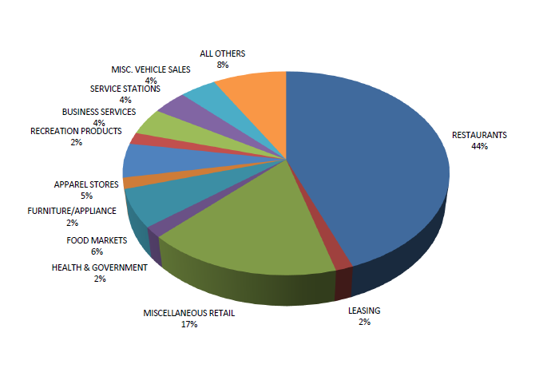
Transactions and Use (Sales) Tax
Notes:
Muniserives and Claritas Nielsen site reports minimum of 40% capture, to Chamber 80%

Slide 10
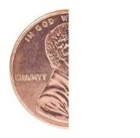

Election Procedures / Timeline
July 8, 2014
Report to City Council on Transaction and Use Tax.
Resolution calling for consolidation of election, ½¢ Sales Tax Ordinance.
July 22, 2014
August 8, 2014
Last date to submit ballot measure to County of Marin.
5 PM deadline for submittal to City Clerk of ballot arguments for/con; and,
City Attorney impartial analysis.
August 18, 2014
August 25, 2014
5 PM deadline for submission to City Clerk rebuttals to arguments.
General election
November 4, 2014
April 1, 2015
Sales Tax effective date.

Slide 11
Capital Infrastructure Needs
The City does not currently have the funds to adequately address critical infrastructure needs.
Maintaining and Repairing 85-year-old Storm Drains
Storm drains are completely deteriorated/rusted through
Upgrades are needed to prevent pollutants, garbage and sediment from entering Richardson’s Bay
Maintaining and Repairing Neighborhood Streets and Fixing Broken Sidewalks
Deteriorating streets on steep hillsides create hazardous conditions
Crowded sidewalks must be maintained for pedestrian safety and access for seniors and the disabled.

Slide 12
Proposal for Enhanced Revenues
Sausalito constituents place a high value on maintaining the City’s fiscal stability and place a high priority on a number of key services.
In order to improve essential City services that impact Sausalito’s quality of life, by almost a two-to-one margin a solid majority (61%) of constituents say they would be supportive of a potential temporary local sales tax measure to address community needs.
The City of Sausalito Essential City Services ½¢ Sales Tax Measure should generate approximately $1 million annually.

Slide 13
A Temporary Local Sales Tax Generates Local Funds for Local Needs
Would ensure a guaranteed source of local funding to improve essential City services that cannot be taken by Sacramento
Tax dollars would be spent locally for Sausalito residents
With tens of thousands of tourists coming to Sausalito each year to shop, would ensure that out-of-towners pay their fair share for the strain they place on local services when they visit our city
Is not applied to food purchased as groceries or prescription medication
Recommended fiscal accountability provisions:
Requiring independent financial audits with public review
Including a sunset/is temporary
Requiring all funds to remain in Sausalito

Slide 14
Recommended Motions
Staff recommends that the City Council of the City of Sausalito, move to:
Approve a resolution to call an election to be held on November 4, 2014 submitting to the voters an ordinance imposing a one-half cent (½¢) transactions and use (sales) tax for general purposes to be administered by the California State Board of Equalization.
Introduce and read by title only an Ordinance of the City of Sausalito adding Chapter 3.06 to Title 3 of the Sausalito Municipal Code Imposing a Transactions and Use Tax to be Administered by the State Board of Equalization (November 4, 2014 Ballot)

